Slide 1
My Life Story

Slide 2
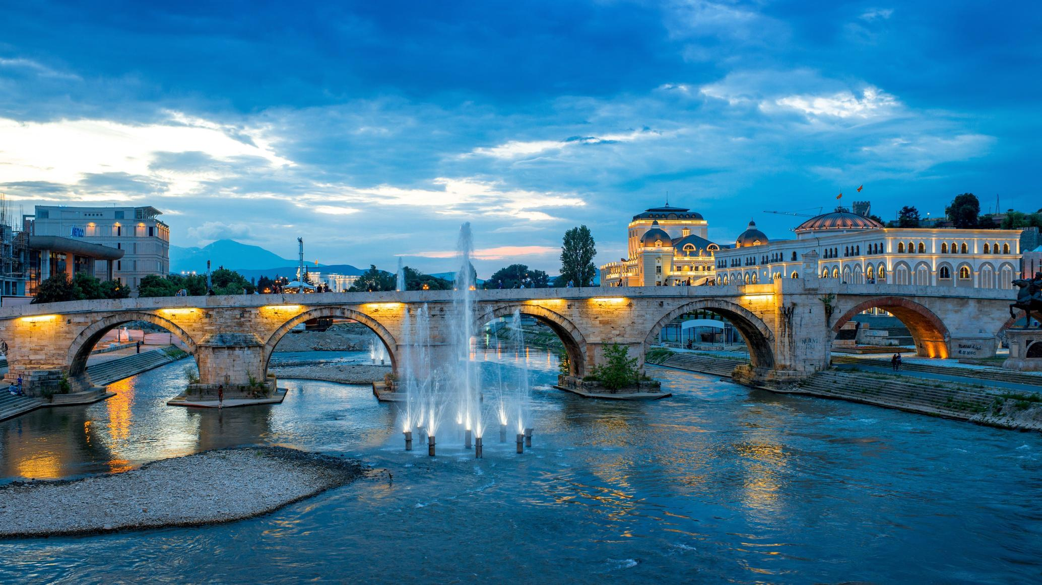
My name is Konstantin Pandilovski
I am 21 years old
I am from Skopje.

Slide 3
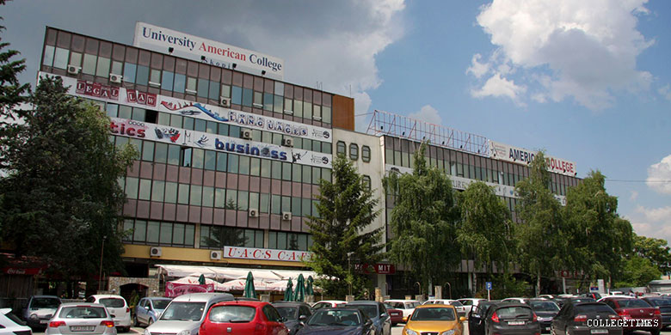
My academic journey:
I finished primary School in Dimitar Miladinov
I finished High School in Rade Jovchevski Korcagin
I currently getting my Bachelors Degree at UACS School of Computer Science and Information Technology

Slide 4

My hobbies/interests:
Playing the Piano and music in general
Coding/Networking
National dances
Swimming

Slide 5
THE END

